Slide 1
Masked Autoencoders Are Scalable Vision Learners
2021
鄧仲恩
NTUST GAMELab

Slide 2
Outline
Introduction
Related Work
Method
Experiments
Conclusion
NTUST GAMELab

Slide 3
Introduction
NTUST GAMELab

Slide 4
Introduction
Deep learning today can easily overfit million of images and begin to demand often publicly inaccessible labeled images.
NLP solve this problem by self-supervised pretraining. The solutions based on autoregressive language modeling(GPT) and masked autoencoding (BERT).
NTUST GAMELab
Notes:
1. labeled images不好取得
2. conceptually simple: they remove a portion of the data and learn to predict the removed content. These methods now enable training of generalizable NLP models containing over one hundred billion parameters.

Slide 5
Introduction
Autoencoding methods is success in BERT, but progress in vision lags behind NLP. what makes masked autoencoding different between vision and language?
CNN were dominant in vision over the last decade. Convolutions operate on regular grids and it is not easily put mask tokens(BERT) or positional embeddings.
Languages are highly semantic and information-dense. Images with heavy spatial redundancy.
In vision, autoencoder’s decode output a lower semantic level than recognition tasks. Contrast to language, decoder predicts missing words that contain rich semantic information.
NTUST GAMELab
Notes:
1.VIT
2.
去除幾個單詞即會造成理解上的困難
a missing patch can be recovered from neighboring patche
為了學到更好的特偵 masking avery highportion of random patches.
這個策略需要還原刪除部分 也因此創造具有挑戰性的自監督任務 強迫模型必須理解高維特偵

Slide 6
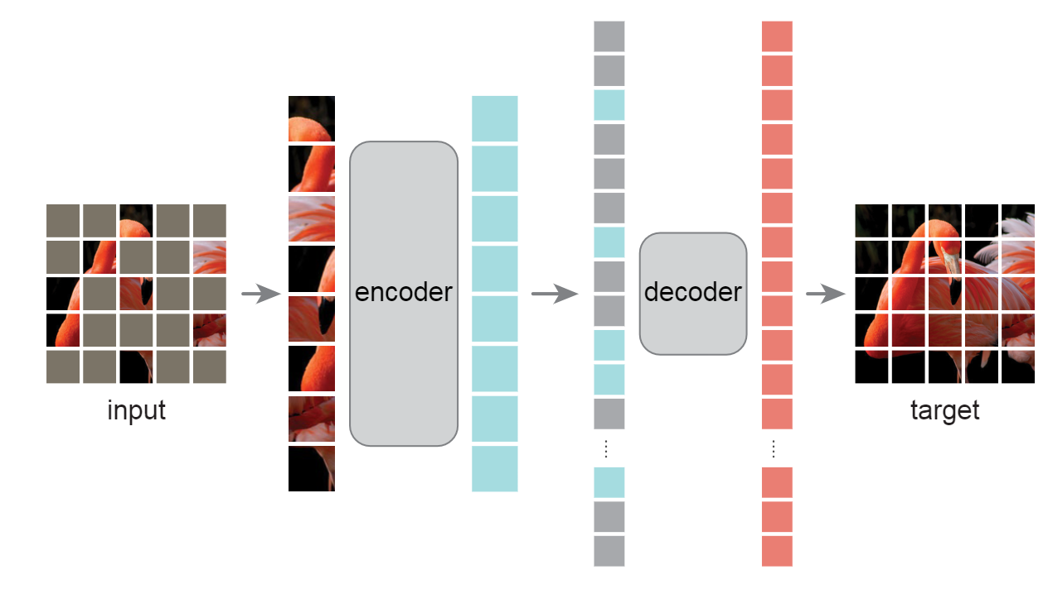
Introduction - masked autoencoder (MAE)
Masks random patches and reconstructs missing patches.
Asymmetric encoder-decoder design.
Encoder on visible patches.
Decoder reconstructs latent representation along with mask tokens.
With MAE pre-training, ViT-Large/-Huge achieve 87.8% when finetuned on ImageNet-1K.
Transfer learning on object detection, instance segmentation, and semantic segmentation achieves better results than its supervised pretrain.
NTUST GAMELab
Notes:
轉移

Slide 7
Related Work - Masked language modeling
BERT and GPT are highly successful methods for pre-training in NLP.
These methods hold out a portion of the input sequence and train models to predict the missing content.
NTUST GAMELab

Slide 8
Related Work - Autoencoding
BERT and GPT are highly successful methods for pre-training in NLP.
These methods hold out a portion of the input sequence and train models to predict the missing content.
NTUST GAMELab

Slide 9
報告完畢 THE END
謝謝 Thank You
NTUST GAMELab

